Slide 1


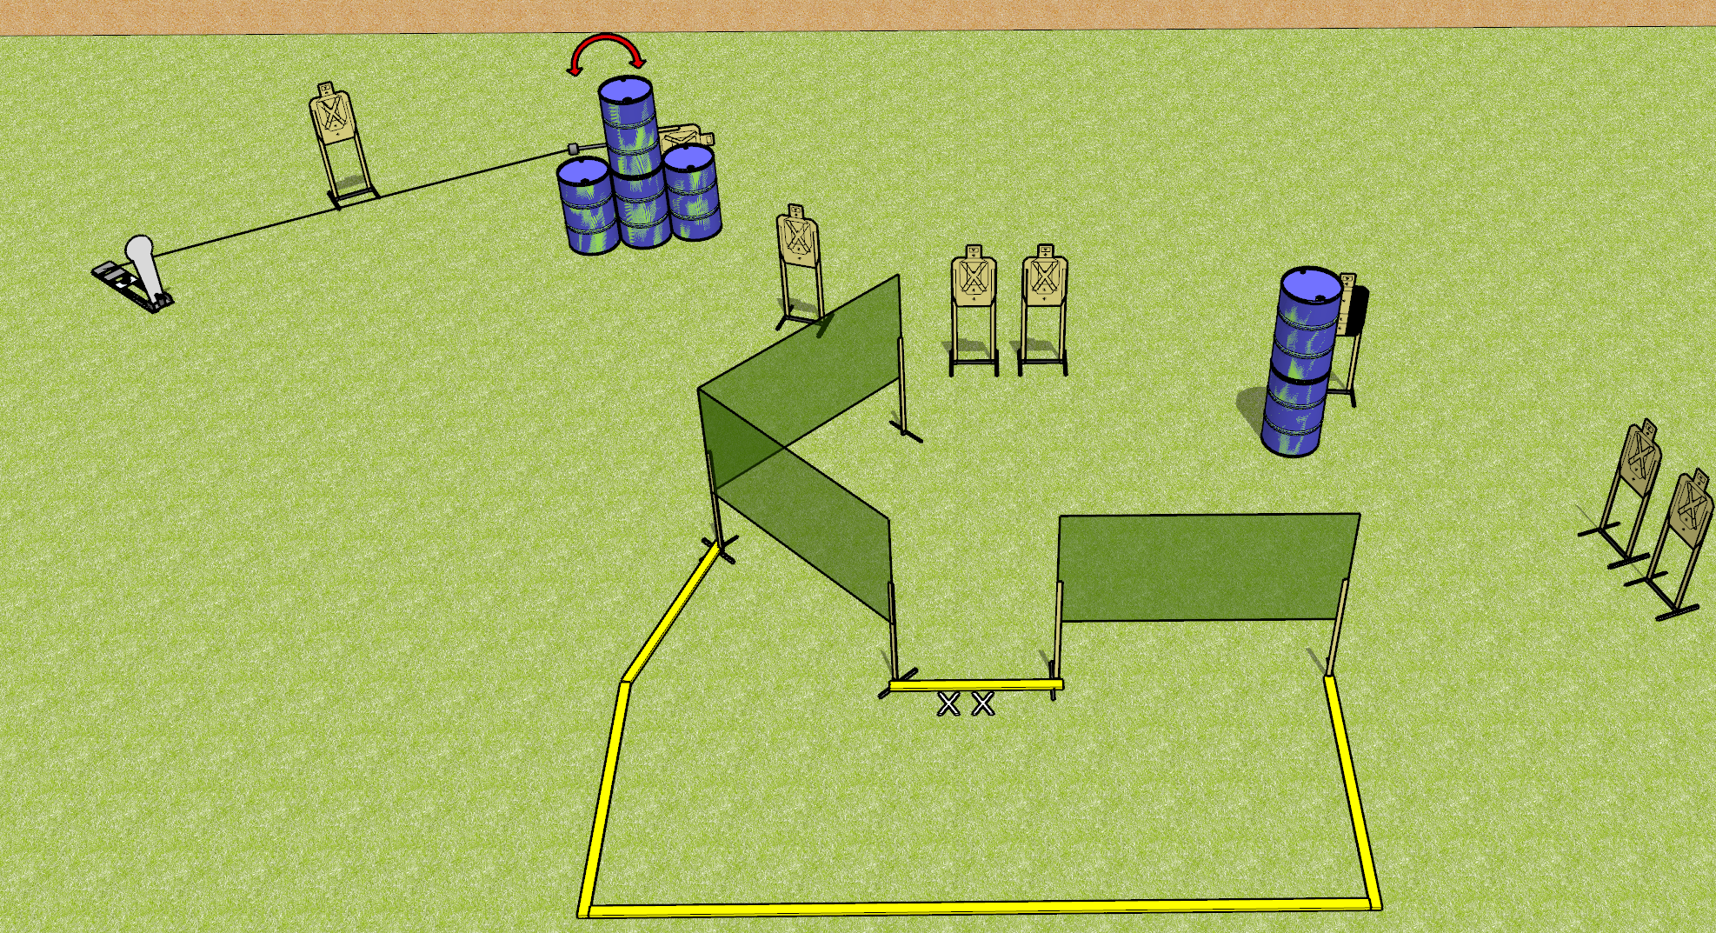
 | Dothan Gun Club – USPSA Match Short and Sweet Course Designer : Drew Coleman
Round Count 17 rounds 8 USPSA targets 1 colt popper
Equipment List 5 wall feet 1 swinger + activator 2 medium fault lines, 2-3 medium, 2 10 foot, 2 8 foot

Slide 2
Short and Sweet
Written Stage Briefing
Short and Sweet is a 17 round, 85 point, Comstock course of fire. There are 8 USPSA targets and 1 colt popper. The best 2 hits on paper will score, and steel must fall to score. The start signal is audible.
Handgun start position is both feet on X’s, wrists above shoulders. Handgun is loaded and holstered
PCC start position
Stage Procedure

